Slide 1




MECHANICAL
CABLE DESIGN AND PROTECTION
04/09/21
Kristine Chelakkat
Specifications
Wire:
4 cables
High Voltage, 3000V
Shielded
Helps reduce electromagnetic and radio frequency interference from other devices
Important due to high voltage and proximity to other electrical components
Insulating outer coating
Connectors:
Able to keep dust out

Slide 2
MECHANICAL
CABLE DESIGN AND PROTECTION
04/09/21
Kristine Chelakkat
Cicoil
Approved by NASA for space flight; Used in Apollo
Up to 12-20kV DC (depending on gauge size)
Shielding: 90% nominal coverage
Temperature Rating: -104C to +165C
Outer Jacker Dielectric Strength: 450 volts/mil
Comes with connectors attached

Slide 3
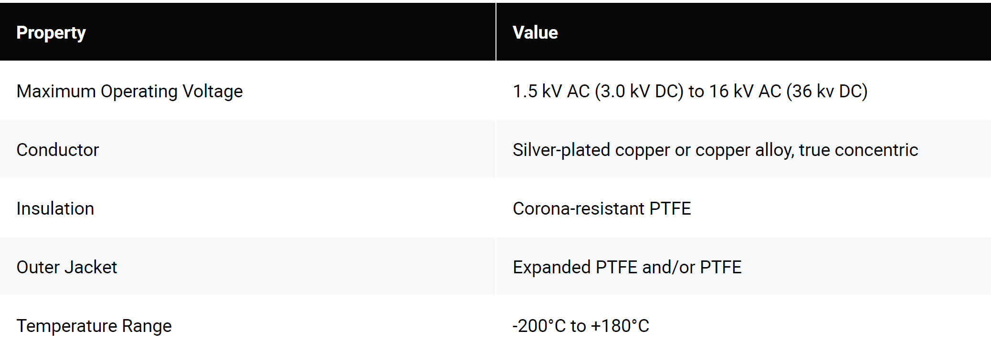
MECHANICAL
CABLE DESIGN AND PROTECTION
04/09/21
Kristine Chelakkat
Gore
Previously used in space missions like Apollo and Mars Rover, and many other satellite missions
No information about connectors – may have to manually add

Slide 4
MECHANICAL
CABLE DESIGN AND PROTECTION
04/09/21
Kristine Chelakkat
Next Steps
Contacting engineers with HV experience in the space industry
Contacting suppliers for samples
<$20/foot from Cicoil
May be able to request Gore for a free sample
Testing Cable

